Slide 1
Team Case 2
COMM 231
Connor Button, Emily Brodie, Katie Duras, Nolan Dangela, Sydney Conroy
Group 3

Slide 2
Size-Up, Issues, and Insights
Size-Up
External and Internal Issues
Real value to end-user
Increases the customer’s productivity
Painful, serious problem
Four main competitors entered the market
Collaboration with more than 3,000 web applications.
Robust market, margin, $
Has a value over 2 billion
Pricing is lower than that of competitors except for Integrately.
Good fit, timing
MurhamCo already has a strong reputation.
AI is becoming more prevalent.
MurhamCo’s current target market is broad.
Rise in competitors, who are surpassing MurhamCo in some aspects.
Their integrated marketing communication consists mainly of content marketing.
Pricing is lower than that of competitors.

Slide 3
Performance Goals
Increase activation of MurhamCo by those signing up.
Limit the number of customers who choose to cancel their subscriptions each month.
Match competitors on how easy MurhamCo can be to operate.

Slide 4
Marketing Strategy Overview
Target Mid-Market customers
Position on fastest Time-to-Value
Modernize onboarding
Raise pricing + margins
Use balanced IMC plan to lower CAC

Slide 5
ICP Described
Shift towards mid-market focused while still maintaining Small market customers
Segment | Size | Pain Points | Murham Co
Small Market | 0-50 | Low budget and lack of tech expertise. | Flexible Price options and 1 click set up.
Mid Market | 50-1000 | Limited developer resources for integrations. Pressure to prove ROI. Highlight fast setup, clear ROI, and scalable integrations | Emphasize “NO-Code”.Highlight fast setup, clear ROI, and scalable integrations. Use IMC to build trust
Enterprise | 1000+ | High implementation and support costs. Less price sensitive but needs quality support | Compete through premium packages and dedicated enterprise support.

Slide 6
Positioning Described
Time to Value
Focus: Speed of delivering value to customer
Goal: Differentiate by reducing friction between adoption and benefit realization.
Example: “Get real results in days, not months”
Shows a measurable ROI by positioning MurhamCo as the company that provides value quickly.
Most automatable processes at all levels
Ability to buy additional tasks/month
Statement: “For teams who need automation without IT bottlenecks, MurhamCo delivers the fastest time-to-value in the category; combining enterprise-grade app coverage with true no-code simplicity unmatched by MuleSoft, Workato, Celigo, and Integrately.”

Slide 7
Total Customer Experience
High churn and declining sign-up to activation rates indicate a gap after acquisition.
Mid-market users may require more guidance than current self-directed program.
Modernizing onboarding with a hybrid model: Self-serve and optional human assisted component.
Clearer onboarding and support can increase activation rates.
Enhancing post-purchase experience by notifying client on the time saved can increase retention.

Slide 8
Revenue Model, Pricing, and CAC:LTV
Revenue Model
Pricing
CAC:LTV
2025- MurhamCO had around 55800 paying customers and $55M ARR
2026- With the new IMC plan it’s estimated monthly growth from 2.1% to 3% reaching now 68-70k customers
ARR now grows to approximately 80M
-Increases price by around 10-15% to align with Celigo’s mid-market rates
Average revenue per customer rises from $1000-$1,150 per year
Improved positioning and margins increases their gross margin from around 78% to 82%
CAC drops from $2,000-$1700 (-15%) through diversified marketing as well as inside sales
Churn falls from 5.4% to 3.8% per month extending customer lifetime from 18 to 26 months
LTV Increases from 9000-11,250 (+25%)
LTV:CAC ratio improves from 4.5:1 - 6.6:1

Slide 9
Distribution and IMC
Lever | Sales Agents | Paid Ads/SEO/SEM | Content Marketing | Partner Sales
Allocation ($18m) | $9.0m (50%) | $3.6m (20%) | $3.6m (20%) | $1.8m (10%)
Distribution Focus | Inside/Outside-Sales | Self-Service/PLG | Self-Service/PLG | Partnerships
Justification [focused on reducing CAC] | - Largest cost driver - Segment conversion - Staff Funding - Converts Leads | -Builds awareness - Assists with LLM optimization - Volume lever - User-initiated | - Continuing content - Strengthens organic acquisition - Supports awareness without cost increase | - Builds credibility - Trains and certifies partners - Expands reach further - Co-Market availability

Slide 10
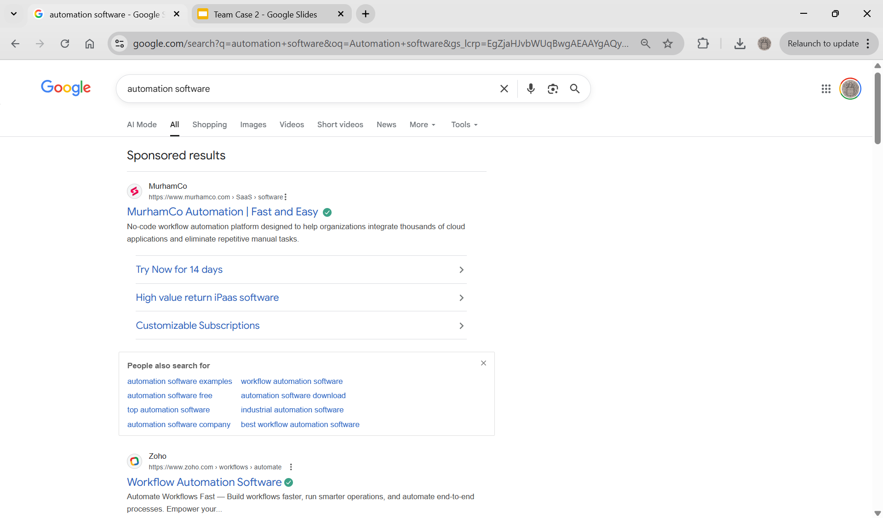

Slide 11
Risks and Summary
Loss of market share:
Risk:
Alienation of small-businesses, may increase the already increasing churn.
Mitigation:
Maintain low cost plans to keep current small-business customers.
Utilize inside-sales segment to increase customer support and CRM.
Hone positioning to differentiate from competitors, primarily Celigo and Integritaley.
Slow Mid-Market adoption:
Risk:
Mid-Market companies may not resonate with TTV positioning.
Mitigation:
Strengthen TTV positioning with customer success studies utilizing content marketing.
Sales platform to push free and starter bundles to show measurable value.
Use partnerships and co-marketing content to reinforce mid-market identity.
Competitive Differentiation
Risk:
Replication of TTV model by competitors.
Celigo lowers prices to compete/changes to subscription model instead of custom programs
Mitigation:
Utilize first movers advantage to strengthen brand identity and program, further from competitors.
Use internal agents to further enhance customer benefit.

Slide 12
Appendix (Size-Up, Issues)
5C Analysis
Customers: small organizations, mid-market, and enterprise organizations.
Collaborators: more than 3,000 web applications.
Competitors: Salesforce/Mulesoft, Workato, Celigo, Integrately, and n8n.
Context: AI is now more prevalent.
Company: In prior years, the company has achieved great success. They have knowledgeable employees; however, they face financial and human resource challenges.

Slide 13
Appendix (Positioning)
Competitor | Product Characteristics | Segment Focus | Implications for time to Value | Why MurhamCo Wins on TTV
Mulesoft | • Provides an API platform • Not no-code like MurhamCo • Designed for large-scale integrations | Primarily large enterprises | • API-driven and developer-oriented integrations inherently require more technical setup • Enterprise clients typically go through longer implementation cycles | Point, Click, and Automate model avoids API development → faster setup, fewer technical steps, rapid TTV for mid-market teams without IT capacity
Workato | • Also no-code, but focused on “recipes” (pre-built instructions) • Provides packaged flows by function and app | Mid-market (38%) and Enterprise (35%) | • Recipes must be selected, adapted, and configured → introduces more upfront selection work • Larger enterprise focus implies more complex use cases → longer time to initial value | Enables users to build workflows without recipe configuration, speeding up trial → activation → value in the “End-User Era” where daily usefulness matters
Celigo | • Hybrid: no-code flow builder + REST/HTTP/SQL/JS extensions • Has an integration marketplace | Mid-market | • Hybrid no-code + developer scripting increases complexity → slower onboarding, more steps before first usable workflow • Marketplace integrations require selection + setup | MurhamCo avoids developer tooling entirely → less setup friction, ideal for mid-market buyers who prioritize ease of setup + ease of use
Integratley | • “1-click” integrations • 250,000 ready integrations across 350 apps | Small business | • Very fast setup but limited depth (only 350 apps vs MurhamCo’s 3,000+) • Not designed for mid-market’s more complex multi-app workflows | MurhamCo matches simplicity while offering 10× app coverage (3,000 apps). This gives both speed + depth, which mid-market requires

Slide 14
Appendix (IMC and Distribution)
Lever | Sales Agents | Paid Ads/SEO/SEM | Content Marketing | Partner Sales
Distribution Focus | - Human-led distribution, guiding customers through buying journeys. - Primary channel for mid-market conversion, managing demos, configuration, and onboarding. - Bridges self-serve sector into activated accounts | - Top-of-funnel self-serve acquisition by capturing search intent and routing users directly into signups. - Expands reach by placing MurhamCo where users naturally search for automation solutions. - Fuels PLG by delivering high-intent traffic straight to free trials or product pages. | - Distributes MurhamCo through discovery, pulling users via blogs, tutorials, and guides. - Supports PLG by arming users with knowledge that reduces friction in setup and exploration (books, reports) - Extends product reach as internet traffic. | - Distribution through already used channels (Slack, NetSuite, QuickBooks integrations). - Uses certified partners as deployment channels for new growth (enterprise) - Reaches new markets through co-selling and co-marketing with established technology partners.
Justification, focused on reducing CAC | - Largest cost driver. - critical for mid-market conversion. - Funds sales reps, onboarding specialists, demos, and customer relationship management. - Converts leads from self-service funnel into paid accounts, increasing activations. | -Builds awareness visibility to enable segmentation switch - Assists with LLM optimization to further visibility. - Short-term volume lever while organic channels mature. - Increases user-initiated SaaS purchases | - Continuing existing library content for current customers - Strengthens organic acquisition and activation for PLG funnel. - Supports mid-market awareness without major CAC increase. - Expand content to Co-Market with others | - Builds enterprise credibility - Reduces churn through ecosystem integrations. - Trains and certifies ERP partners (e.g., Slack, QuickBooks, NetSuite). - Expands reach into upper mid-market and enterprise

